Slide 1







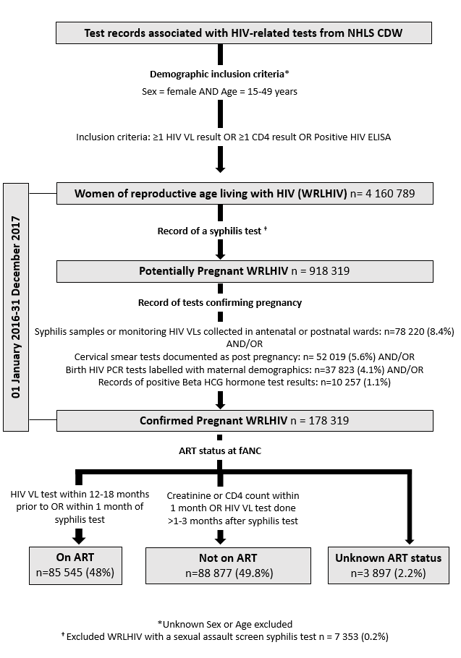
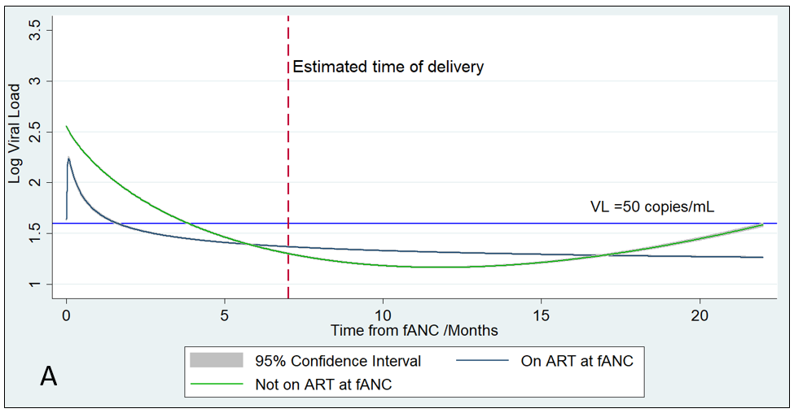
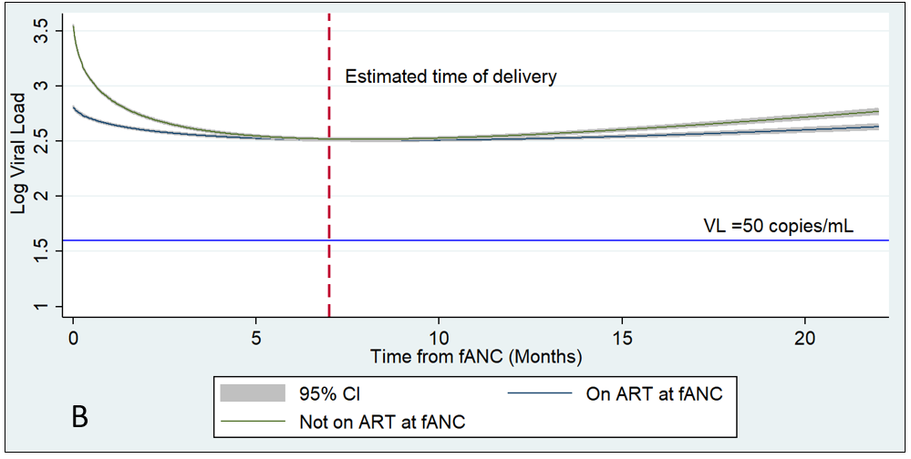
Longitudinal evolution of maternal viral load during pregnancy and up to 15 months postpartum among pregnant women living with
HIV in South Africa
Faith Moyo^{1,2,3}, Ahmad Haeri Mazanderani¹, Tanya Murray^{1,3}, Gayle G Sherman^{1,3,4}, Tendesayi Kufa^{1,3}
1. Centre for HIV and STIs, National Institute for Communicable Diseases, National Health Laboratory Service, Johannesburg, South Africa 2. Paediatric HIV Diagnostics Division, Wits Health Consortium, Johannesburg, South Africa 3. School of Public Health, Faculty of Health Sciences, University of the Witwatersrand, Johannesburg, South Africa. 4. Empilweni Services and Research Unit, Rahima Moosa Mother and Child Hospital, Department of Paediatrics and Child Health, Faculty of Health Sciences, University of the Witwatersrand, Johannesburg, South Africa
*Contact details: faithmo@nicd.ac.za
PEB0281
Background
Elimination of mother-to-child transmission of HIV (eMTCT) requires sustained maternal viral suppression during pregnancy, at delivery and postpartum during the breastfeeding period
HIV screening and antiretroviral therapy (ART) initiation amongst antenatal attendees is near universal at >95% coverage in the public health sector in South Africa
Viral load suppression (VLS) rates in pregnant and postpartum women living with HIV (WLHIV) are not well documented
Using the National Health Laboratory Services (NHLS) dataset, we describe the evolution of maternal VL during pregnancy, at delivery and up to 15 months postpartum among WLHIV within the public health sector in South Africa
Table 1. Demographic and clinical characteristics of pregnant WLHIV in South Africa, comparison of NHLS CDW dataset 2016 vs. 2017
Methods
HIV VLs and pregnancy-related tests performed between January 2016-December 2017 from the NHLS’ Corporate Data Warehouse (CDW) were used to create a synthetic cohort of pregnant WLHIV aged 15-49 years as described in Figure 1
Syphilis screening, in conjunction with ward type and/or post-pregnancy cervical screening and/or birth HIV PCR and/or positive β-hCG, was used as a proxy for pregnancy
Syphilis screening was assumed to occur at first antenatal care visit (fANC)
Cohort entry was at fANC and follow-up was up to 15 months from the estimated date of delivery
Laboratory testing patterns prescribed by national HIV treatment guidelines determined ART status at fANC
VL changes during follow-up were described using fractional polynomial models and proportions of viraemic women at different time-points were calculated
Piecewise linear regression models determined factors associated with VL decline during follow-up
Results
Among 178 319 pregnant WLHIV, 345 174 HIV VL tests were performed [median=2 (IQR: 2-3) per woman]. At fANC, 85 545 (48·0%) women were receiving ART; 88 877 (49·8%) were not and 3 897 (2·2%) were unknown (Table 1)
Among women with detectable HIV VL, mean predicted VL at first VL measurement during pregnancy started at 3·06 log₁₀ VL copies/mL [95% CI: 3·05-3·08] in 47 631/74 066 (64·3%) women, decreasing to 2·55 [2·53-2·58] at delivery in 20 773/40 016 (51·9%) women and 2·52 [2·51-2·54] postpartum in 34 881/72 673 (47.9%) women. Figure 2 shows VL decline during follow-up with increases late postpartum.
Of 23 904 (32.2%) women with a first HIV VL performed during pregnancy of ≥1 000 copies/mL, 8 980 (37.6%) had a VL <1 000 VL and 7 971 (33.3%) had VL ≥1000 copies/mL after 3·7 (IQR: 2·6-6·0) months between the two VL measurements, while 6 953 (29.1%) had no follow up VL.
Proportions of maternal viraemia at delivery were 36·9% and 14·3% for VL ≥50 and ≥1000 copies/mL thresholds respectively
Maternal age ≥25 years, CD4 count ≥500 and VL <50 copies/mL at baseline predicted HIV VL decline during follow up
Figure 1. Criteria for identifying HIV Viral Load tests performed on pregnant women living with HIV, in the NHLS CDW between 1 January 2016-31 December 2017
*Observed HIV VLs. Abbreviations: : NHLS CDW National Health Laboratory Services’ Corporate Data Warehouse; fANC first antenatal care visit; IQR interquartile range; ART antiretroviral therapy; PCR polymerase chain reaction; HCG human chorionic gonadotropin. VL viral load; cps/mL copies per millilitre; †Comorbidities defined by positive test for at least one of the following conditions: syphilis, poor kidney function or tuberculosis; LDL lower than detectable limit.
Conclusion
Despite high ART coverage during pregnancy, only 63% of pregnant WLHIV reached VL <50 copies/mL by time of delivery
A third of maternal VL ≥1 000 copies/mL requiring intervention at first HIV VL measurement during pregnancy were not acted upon
Findings underscore the need for closer VL monitoring in pregnancy and postpartum periods to achieve eMTCT
Figure 2: Viral load decline over time by ART status at first antenatal visit (A) Overall; Number of HIV VL measurements= 338 688, Log10 HIV VLs of observed HIV VLs that were lower than detectable limit of assay were assigned a value of zero (B) Among women with quantifiable VL, number of HIV VL measurements= 192 140.
Acknowledgements
The authors acknowledge Dr Trevor Bell and Mrs Sue Candy from the NHLS CDW for providing laboratory test data and the ELMA Foundation for financial support.

